Slide 1


Third Way
  National Signal Poll
August 2025
n = 2,000 registered voters nationwide
Conducted July 12-21, 2025 via online panel
Margin of error = +/- 2.2 percentage points

Slide 2
Key Findings
Trump’s standing has declined and he’s clearly underwater now.
The Republican Party’s favorability has dropped, but the Democratic Party’s remains worse
The GOP budget bill is quite unpopular, especially among Independents;
Attacks on Congressional GOP land hardest when tied to the budget bill;
  Medicaid cuts really stand out
  Bankrupting America also a big problem, particularly for some Trump voters
Democrats need a vision to be agents of change. Stopping self-serving politicians, protecting Social Security, and rewarding hard work meet the moment.

Slide 3

Political Landscape

Slide 4
Small Decline In Direction Of Country Driven By Independents
Direction
Right direction
Right Direction – Wrong Track Margin
Wrong track
Dem
Ind
Rep

Slide 5
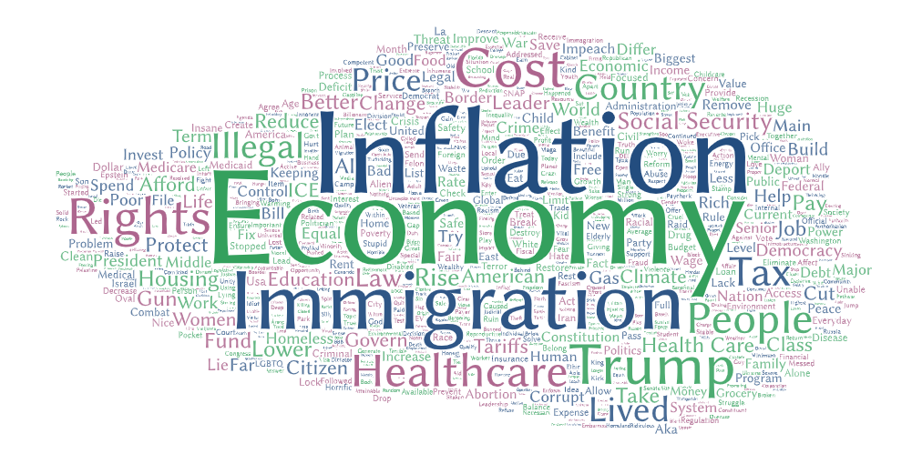
Economy, Inflation, And Immigration Remain Top Priorities
Top Issue
What is the top issue you want your elected leaders in Washington D.C. to focus on? (open end)
“Focus on inflation and how we can lower the prices on gas and groceries.”
“The economy and Trump and all of the tariffs.”
“Immigration. We need to close our borders and get people out that don't belong here. And, create programs that would help the good immigrants come in legally.”
“I think healthcare, offering more services for the lower income families. Lowering the price of things.”
“I want them to focus on the economy and building it so it can be stronger. It’s so many people without jobs. Can’t find a job and we’re tired of living like this.”
“I want the issue to focus on the immigration system as the government should create a new program for citizens to participate and stabilize our economy.”

Slide 6
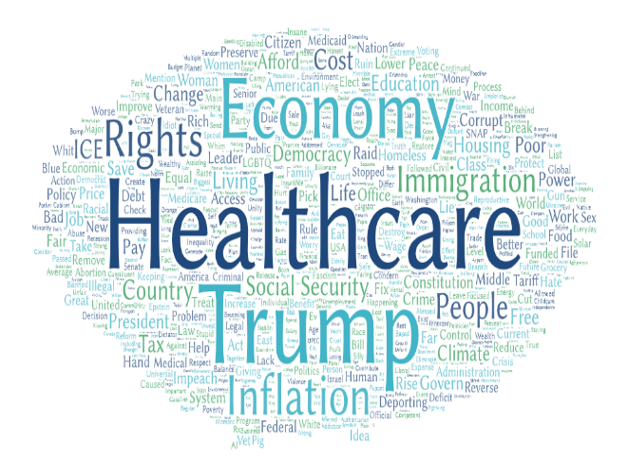
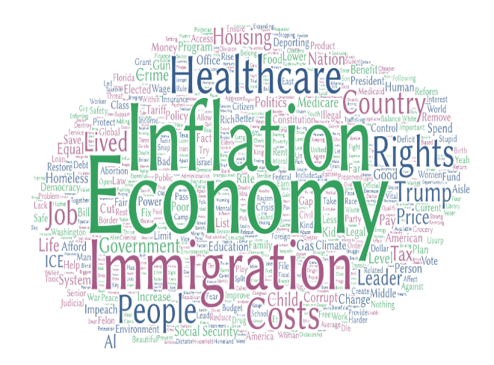
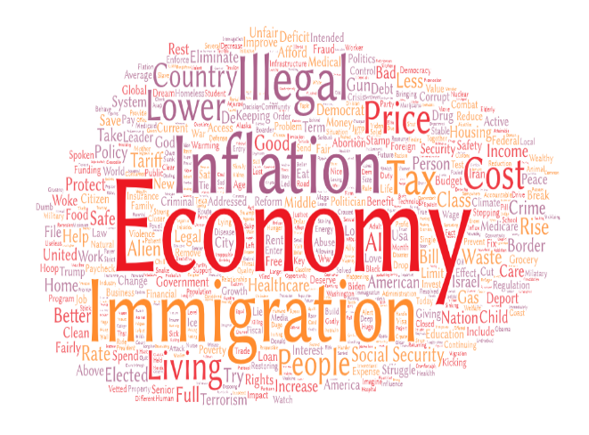
Healthcare Pops For Both Democrats And Independents
Top Issue
Dem
Top Issue
Ind
Top Issue
Rep
"My top issues is the cuts to Medicare and Medicaid and defunding public education. I work with families with disabilities and am a special education advocacy. I see first hand how horrible these executive orders have already affected so many.”
“MAKE GROCERIES MORE AFFORDABLE.”
  “For Americans to be more self-sufficient in things like oil, gas, coal, and producing more of our own foods instead of relying on foreign countries for these supplies and then charge them tariffs”
“I would like the elected leaders to work on improving healthcare, lowering its costs, and improving access to it.”
“Corruption. Useless spending. Too much tax.”
"Getting Donald Trump out of office because he's RUINING our country in every aspect."

Slide 7
Trump’s Favorability Plummets With Independents
Trump Favorability
Favorable
Favorable – Unfavorable Margin
Unfavorable
Dem
Ind
Rep

Slide 8
Trump Losing Ground With Latinos, Young Men, As Well As Other Parts Of His 2024 Coalition
Trump Favorability
March Fav Margin
July Fav Margin

Slide 9
Similar Declines For Trump On Job Approval
Trump Job Approval
Approve
Approve – Disapprove Margin
Disapprove
Dem
Ind
Rep
Darker shade = Stronger intensity

Slide 10
Both Parties Unpopular, Dems Slightly Moreso
Dem Favorability
Favorable
Rep Favorability
Favorable
Unfavorable
Unfavorable
March Fav/Unfav:
45/51
Darker shade = Stronger intensity
*split sample

Slide 11
Nearly All Voters Have Heard At Least Something About The Bill
Budget Recall
As you may know, (Republicans in Congress just passed/President Trump just signed )* a major budget bill. How much have you heard about this budget and the debate surrounding it?
Republicans in Congress*
President Trump*
*Split ½ Sample

Slide 12
Majorities Oppose Budget Bill
Budget Support
(IF HEARD ABOUT BUDGET BILL) And from what you’ve heard, do you support or oppose (the budget bill passed by Republicans in Congress/Trump’s budget bill)?
Republicans in Congress*
President Trump*
Darker shade = Stronger intensity
Darker shade = Stronger intensity
*Split ½ Sample

Slide 13
Medicaid Cuts Stand Out As Major Concern For Budget Bill; GOP Voters Also Concerned By Ballooning Deficit
OBBB Concerns
Please take a look at some of these critiques and indicate which criticism about the budget bill is most concerning to you.
Dem | Ind | Rep
The bill cuts nearly $1 trillion from Medicaid over the next 10 years, costing 12 million people their health coverage. |  | 46 | 37 | 20
The bill increases the national debt by more than $3 trillion over the next 10 years |  | 11 | 19 | 25
Most of the tax cuts will go to households making $1 million or more per year |  | 15 | 13 | 13
Households making less than $50,000 per year will see a reduction in their take-home income |  | 13 | 13 | 13
The bill could force more than half of American nursing homes to cut staff and a quarter to close entirely |  | 7 | 6 | 10
The bill cuts funding for clean energy production and energy efficiency programs, driving up utility bills |  | 5 | 5 | 5

Slide 14

Voters Think Congressional Republicans Have The Wrong Priorities And Are Corrupt, Less Certain They’re “Weak”
Congressional GOP Traits
For each one, please indicate if you think it describes Republicans in Congress very well, somewhat well, not too well, or not well at all.
Well – Not Well
Have the wrong priorities |  | +25
Corrupt |  | +18
Weak |  | -1
% Well
% Not Well

Slide 15
Congressional GOP Has Real Empathy Deficit
Congressional GOP Traits
For each one, please indicate if you think it describes Republicans in Congress very well, somewhat well, not too well, or not well at all.
Well – Not Well
Patriotic |  | +9
Value hard work |  | 0
Cares about people like you |  | -23
% Well
% Not Well

Slide 16
Independent Voters Do Not See Congressional Republicans Putting Constituents First
Which of the following statements comes closest to your own view, even if neither is exactly right?
Most Republicans in Congress blindly follow Trump/are so scared of Trump that they do what he says instead of representing their constituents' interests
Most Republicans in Congress are clear about their values and priorities and try to put their constituents' interests first.
Voted for Trump, term worse than expected

Slide 17

Democrats Have Edge On Health Care, GOP On Border/Security; Big Segments Don’t Trust Either Party
Issue Better
After each, please indicate which party you think would be better at handling that issue - Democrats in Congress or Republicans in Congress
Difference
Total
Ind
% Democrats
% Republicans
+38
+25
+24
+21
+4
+2
-2
-6
-10
-19
-31
+50
+22
+32
+32
+8
+8
-3
-8
-13
-24
-39
*split sample

Slide 18

MaxDiff

Slide 19
Understanding MaxDiff & TURF Data
MAXDIFF
TURF ANALYSIS
MaxDiff scores are normed to 100, where 100 represents the mean average message performance. Any score above 100 is above average, while any score below 100 is below average. A score of 300 is 3 times stronger than average, while a score of 25 is 4 times weaker average.
TURF identifies what “bundles” of messages “reach” the most respondents possible with an average MaxDiff score of 150. It accounts for correlation between messages to find a uniquely strong combination. A high “% reach at step” means the message combination appeals to a large share of the selected audience.
Message | MaxDiff Score
Medicaid Cuts | 182
Give in to Trump | 102
Energy | 45
Message | Step | % Reach at Step
Medicaid Cuts | 1 | 51%
Bankrupt Us | 2 | 66%
Give in to Trump | 3 | 73%
The higher the score over 100, the better it performs compared to a normed average and the lower the score under 100, the worse it performs.
Each “step’s” top reaching message is listed, and the next step is the top reaching message.

Slide 20
Most Effective Attacks Focus On The Items In The Budget Bill, Especially Medicaid
MaxDiff Frames
Mean Score = Average MaxDiff score indexed to 100. Scores above 100 perform better than average, below 100 are less than average.
Average message performance

Slide 21
Budget Bill Items Top Concern Across Partisanship
MaxDiff Frames By Party
Mean Score = Average MaxDiff score indexed to 100. Scores above 100 perform better than average, below 100 are less than average.
Among Democrats
Among Independents
Among Republicans
Medicaid Cuts
Bankrupt Us
Rural Hospitals
Food
Give in to Trump
Deportations
Tariff Chaos
Corruption Schemes
Not Listening
Energy
Average message performance
Average message performance
Average message performance

Slide 22
Food Stamp Cuts Also Stand Out Among Black Voters
MaxDiff Frames By Race
Mean Score = Average MaxDiff score indexed to 100. Scores above 100 perform better than average, below 100 are less than average.
Among White Voters
Among Black Voters
Among Hispanic Voters
Medicaid Cuts
Bankrupt Us
Rural Hospitals
Food
Give in to Trump
Deportations
Tariff Chaos
Corruption Schemes
Not Listening
Energy
Average message performance
Average message performance
Average message performance

Slide 23

Policy Proposals

Slide 24
Top Policy Ideas: Stop Self-Serving Politicians, Strengthen SS, And Reward Work
Policies
Please indicate how much you support the policy on a 0 to 10 scale, where 0 means you don't support it at all and 10 means you strongly support it.
Mean Support Rating
*Strengthen disclosure rules and conflict of interest laws to prevent any politician or their family from profiting off of the office while they are still serving.
*Make it illegal for members of Congress to trade stocks to ensure they can’t get rich from confidential insider information or make decisions that enrich themselves.
Eliminate taxes on Social Security benefits and make the wealthiest pay their fair share into the Social Security system to strengthen it.
Reward people who work hard for a living by letting them keep more of the money they earn, while ending tax breaks for billionaires and big corporations.
*Split

Slide 25
Independents Are Focused On Budget Impacts Too, But Also Oppose Republican Fealty To Trump
Key Group: Independents
POLICIES
TOP MAXDIFF FRAMES
BROADEST TURF REACH
Message | Step | % Reach at Step
Medicaid Cuts | 1
Bankrupt Us | 2
Give in To Trump | 3
Mean Support Rating
Average message performance

Slide 26

Recommendations

Slide 27
Focusing The Fight Against Congressional GOP
Keep the heat on the GOP on their terrible budget – stay focused on Medicaid cuts and who gets hurt (children, people with disabilities and struggling Americans).
The budget’s new debt will bankrupt America and Americans – to put more money in billionaires’ pockets.
And don’t forget to focus on how rural hospitals will get hurt.
Lower testing messages work with certain audiences
  Among independents, hitting Congressional Republicans for fealty to Trump improves otherwise budget focused attacks
  Among disillusioned Trump voters, budget bill items should be augmented with messages against tariff chaos and Republican’s refusing to listen to their constituents

